Slide 1
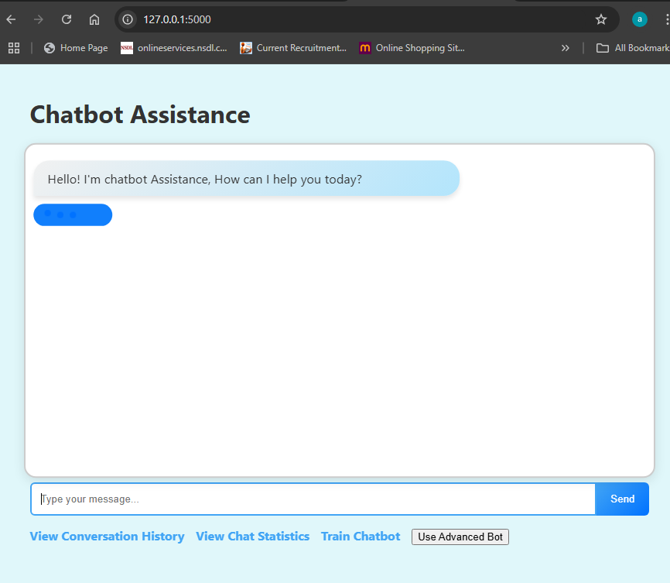
Chatbot Assistance
Ansh uke (AIDSU23030)
Anup Kurhade (AIDSU23031)
Sonal Walivkar (AIDSU23024)
Anuradha Sagane (AIDSU23001)
Shrutika Hage (AIDSU23022)

Slide 2
Tittle & overview
Title: Making a Chatbot that Shows the Applications, History, Advantages, Disadvantages, and Benefits of AI
Subtitle: frontend :HTML, CSSS Backent :Built using Flask and SQLite
College/Department: Pr Pote Patil College of Engineering, AI and Data Science Department
Project Overview:
A chatbot that provides information about AI’s applications, history, advantages, disadvantages, and benefits.
Not yet used: The current version of the code does not have any specific machine learning (ML) algorithm. The code appears to be set up to serve a pre-trained model or process input data, but it lacks the actual ML code.
Built using Flask (Python web framework) and SQLite for database management.

Slide 3
Project Features
Pattern-Based Chatbot:
Matches user inputs with predefined patterns to give accurate AI-related responses.
Conversation History:
Stores all conversations, including user input, bot responses, and timestamps.
Chatbot Statistics:
Provides statistics on user interactions and most common questions.
Custom Pattern Addition:
Users can dynamically add new patterns and responses via a web interface.
Advanced Chatbot Integration:
Leverages the Gemini API for advanced context-aware conversations.

Slide 4
Technical Overview
froentEnd : HTML ,CSS
Backend : PYTON , JAVA SCRIPT
Main Features:
Pattern Matching for AI-related queries.
Database-Driven system for storing interactions.
Customizable patterns via a dynamic web interface.

Slide 5
Benefits and responces
Pattern-Based Responses
Explanation:
Predefined patterns are used to recognize user queries.
Examples of predefined patterns: AI applications, history, advantages, disadvantages, etc.
Benefits:
Ensures accurate and consistent responses to commonly asked questions.
Easy to expand with new patterns.
Use Case:
Provides insights into user behavior.
Helps in improving the chatbot by identifying popular queries.
Key Points:
All user inputs and bot responses are saved in the SQLite database.
Provides a record of past interactions, which users can access via a dedicated web page.
Allows easy tracking and analysis of chatbot performance.

Slide 6
Conclusion how to install ?
Summary:
The chatbot project demonstrates a practical implementation of AI-related information dissemination.
Combines pattern-based responses with advanced API integration to provide accurate and insightful answers on AI.
Closing Statement:
The chatbot can be continuously updated and improved, making it an adaptable tool for educational purposes.
Step 1: Ope visual stidio code
Step 2: Install dependencies with pip install Flask.
Step 3: Initialize the SQLite database.
Step 4: Run the Flask app using python app.py.
Step 5: Access the chatbot at http://127.0.0.1:5000/

